Slide 1
Midterm AI 131
Morgan Rockett

Slide 2
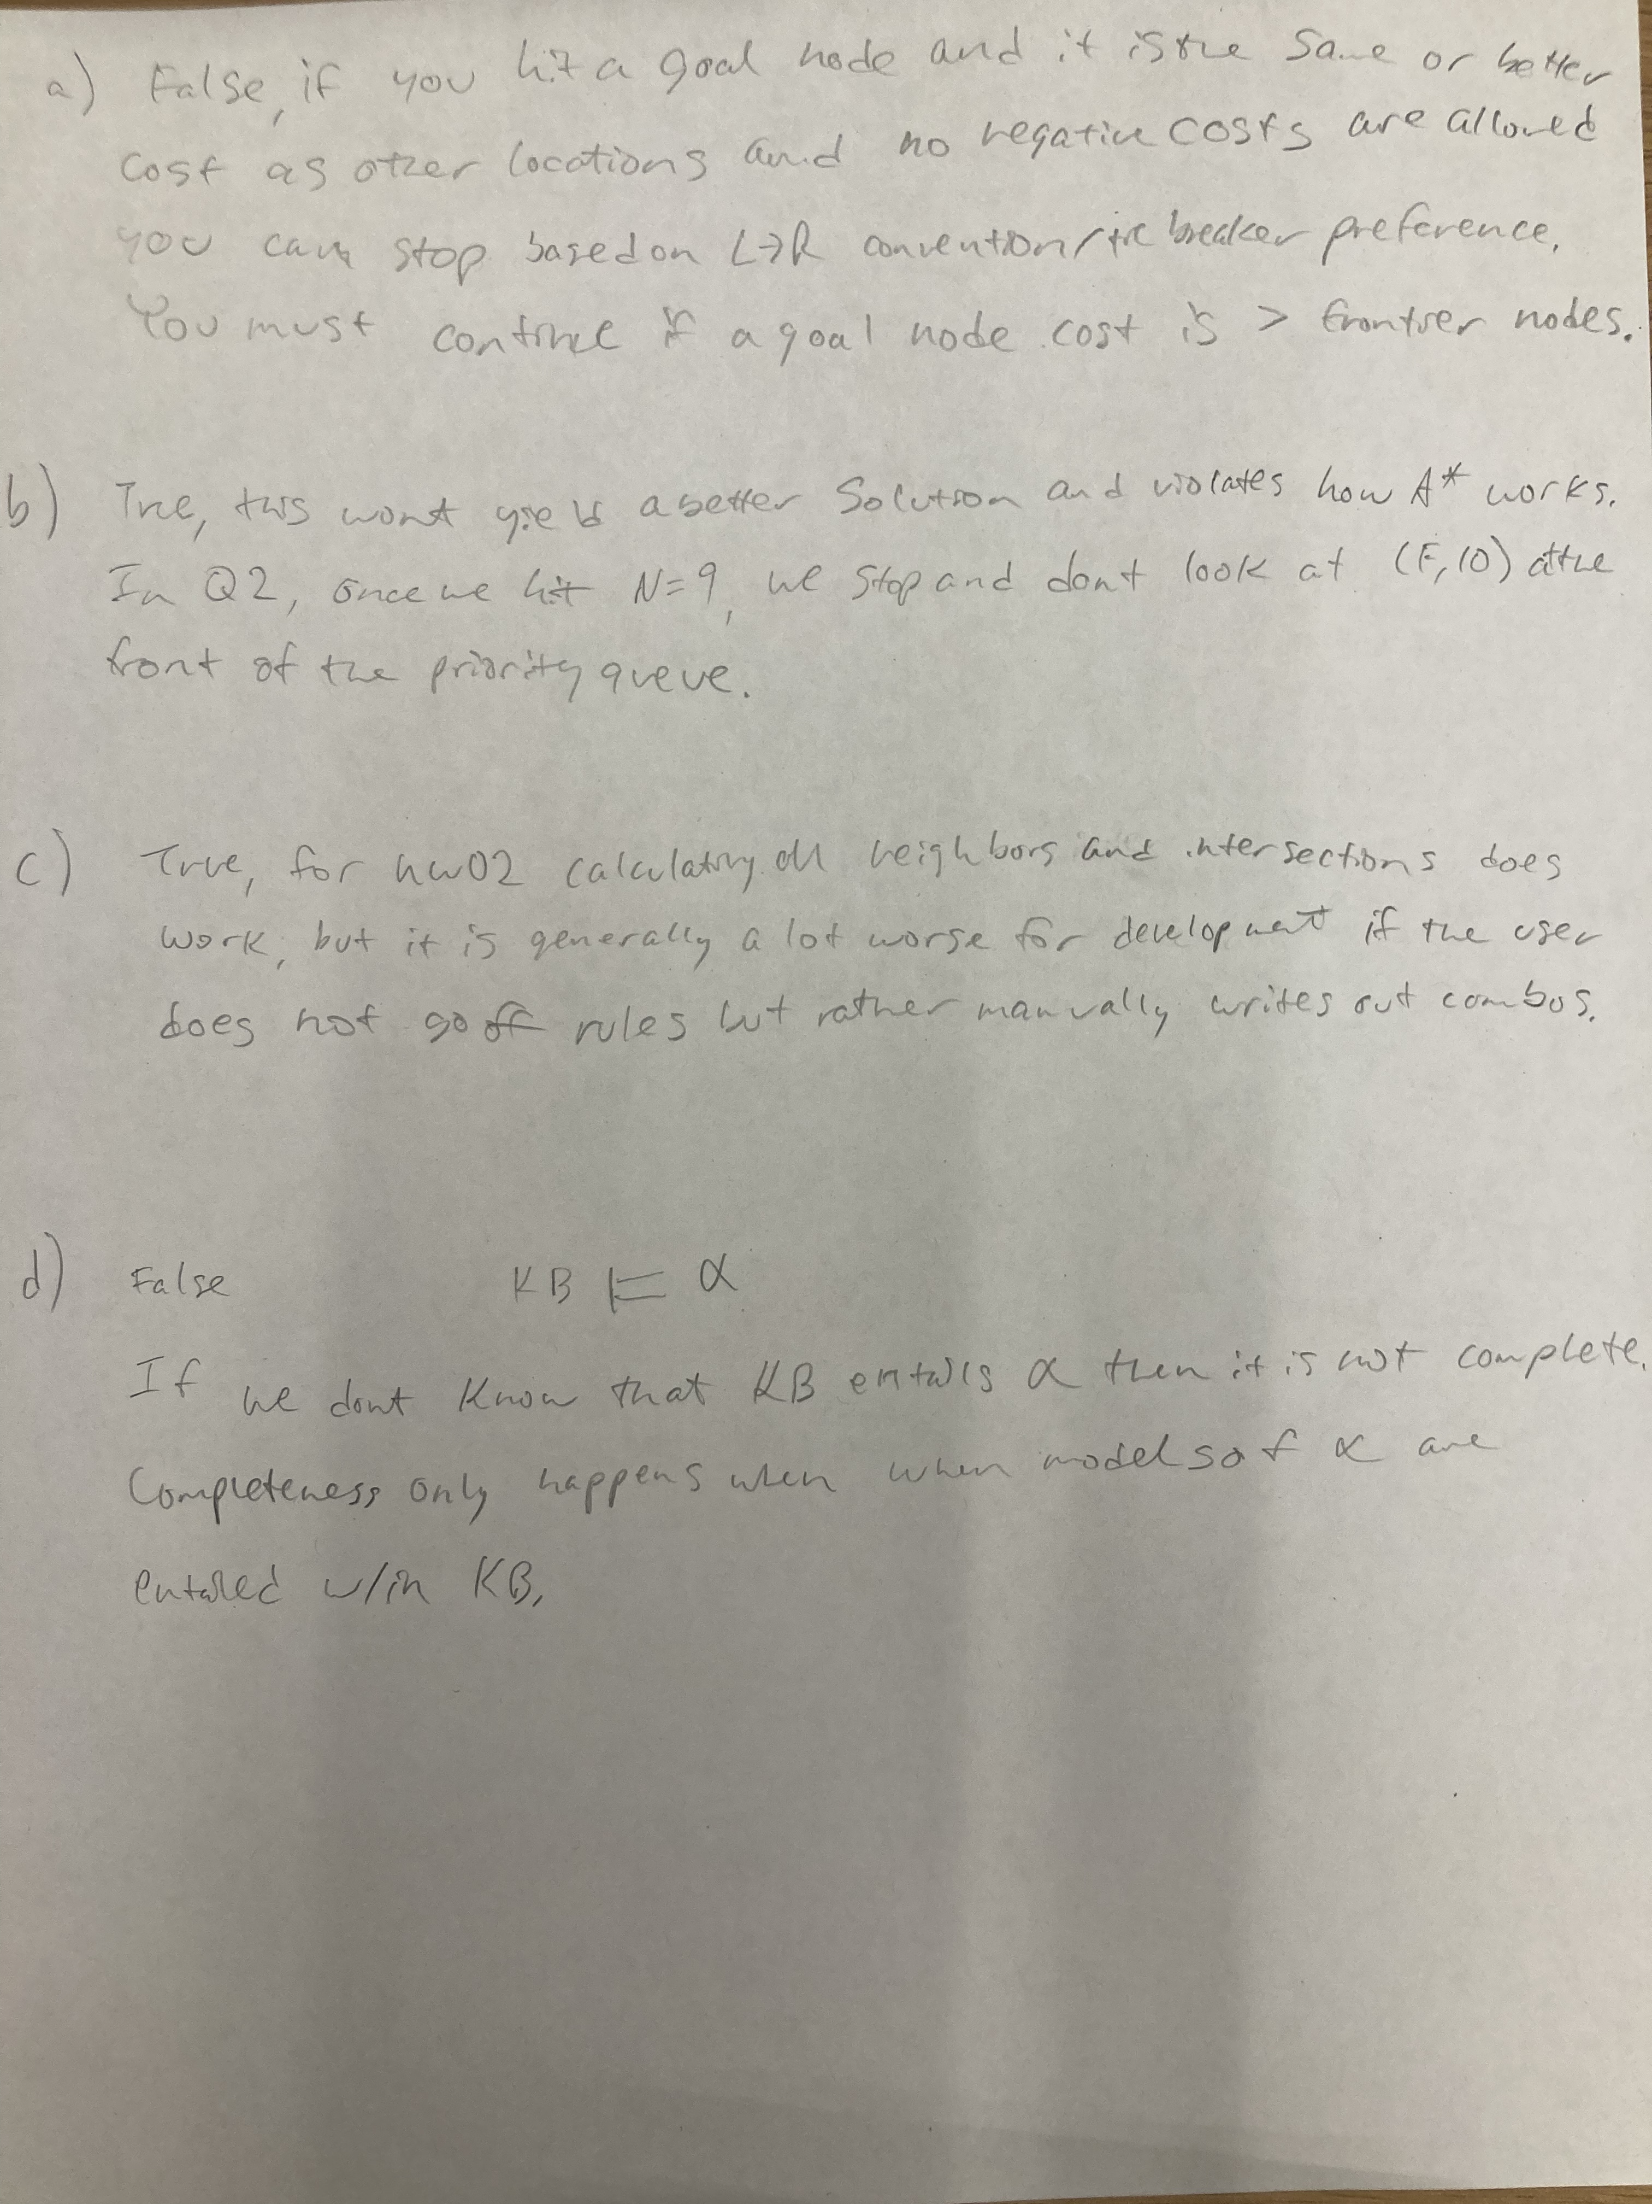
Q1

Slide 3
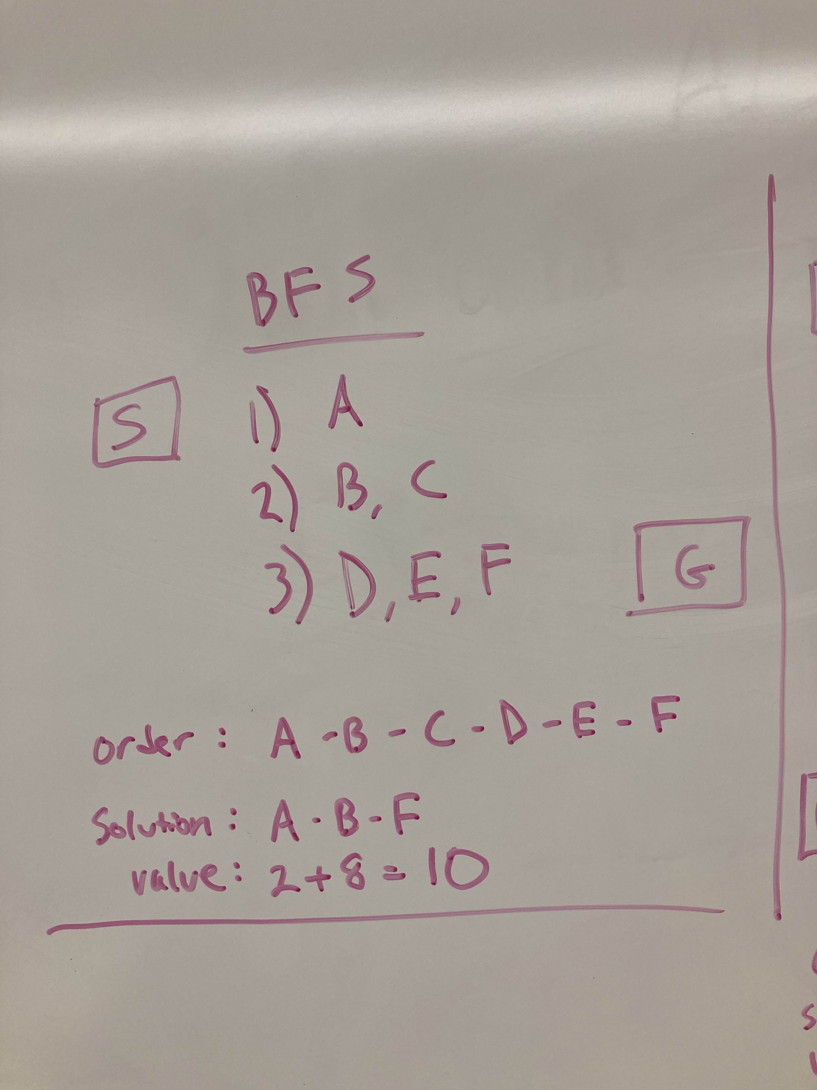
Q2 BFS

Slide 4
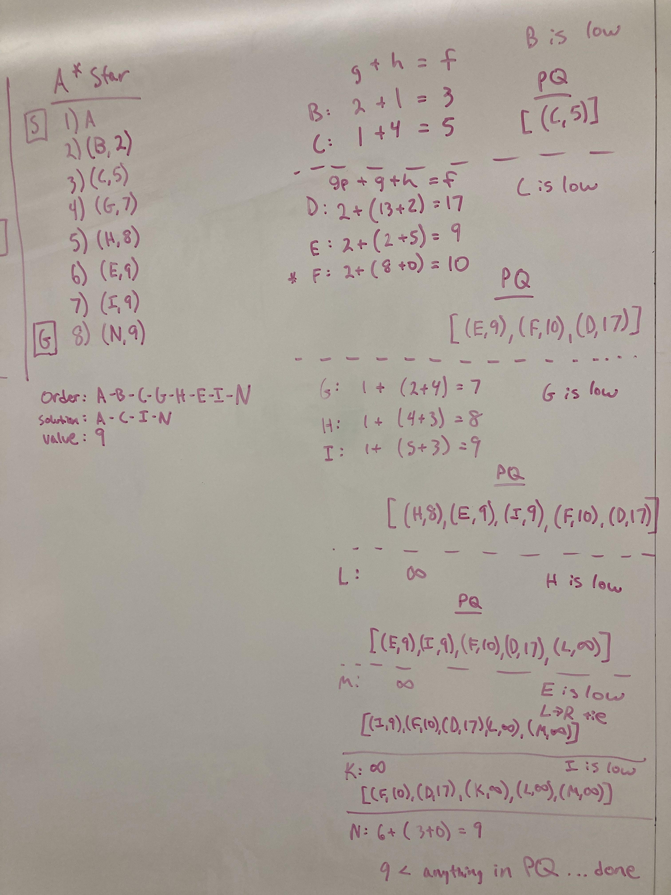
Q2 A* Star

Slide 5
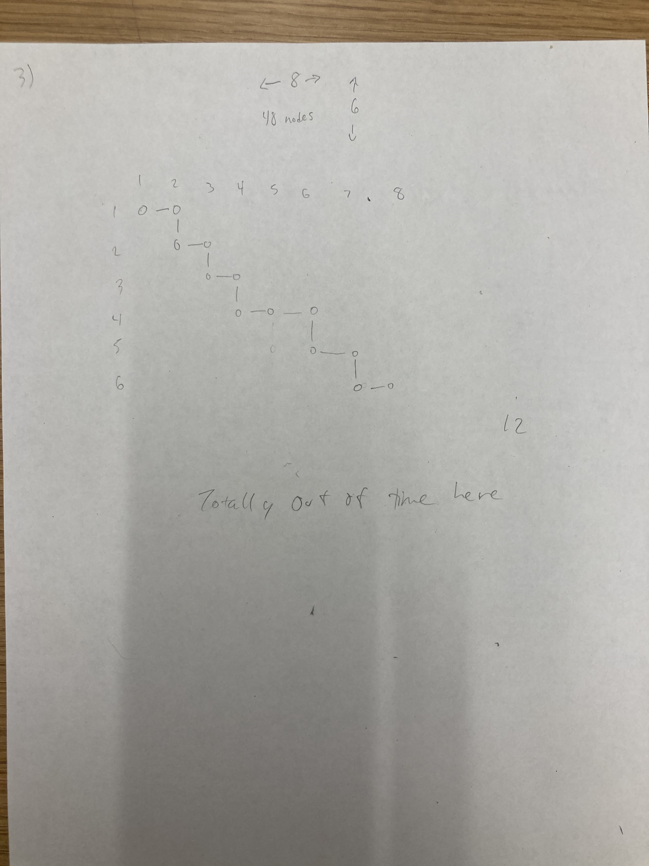
Q3

Slide 6
Q4 CSP
Variables:
Timeslots {1…t}
Classes {1…c}
Classrooms {1…r}
Instructors {1…i}
total variables = t * c * r * i
Constraints
Given a specific timeslot and classroom, there may only be 1 instructor and 1 class
t₁, c₁, r₁, i₁ =/= t₁, r₁, c_{2…n}, i_{2…n}
t₁, c₁, r₂, i₂ =/= t₁, r₁, c_{1,3…n}, i_{1,3…n}
Keeping timeslot and classroom as controls, it is not possible to have any other
instructor or any other class in the same classroom at the same time
Given a specific class and time, instructors can’t match
@ (t₁, c₁) i₁ =/= i_{2…n}
Instructor 1 can’t be any other instructor
Given a specific class and time, classrooms can’t match
@ (t₁, c₁) r₁ =/= r_{2…n}
classroom 1 can’t be any other classroom
At each timeslot we must have enough classrooms for all the classes taking place
@ t_{1…n} (r_{1…n} >= c_{1…n})
r indicates # of classrooms
c indicates # of classes
There must be enough instructors at each timeslot to teach each class
@ t_{1…n} (i_{1…n} >= c_{1…n})
i indicates # of instructors
c indicates # of classes

Slide 7
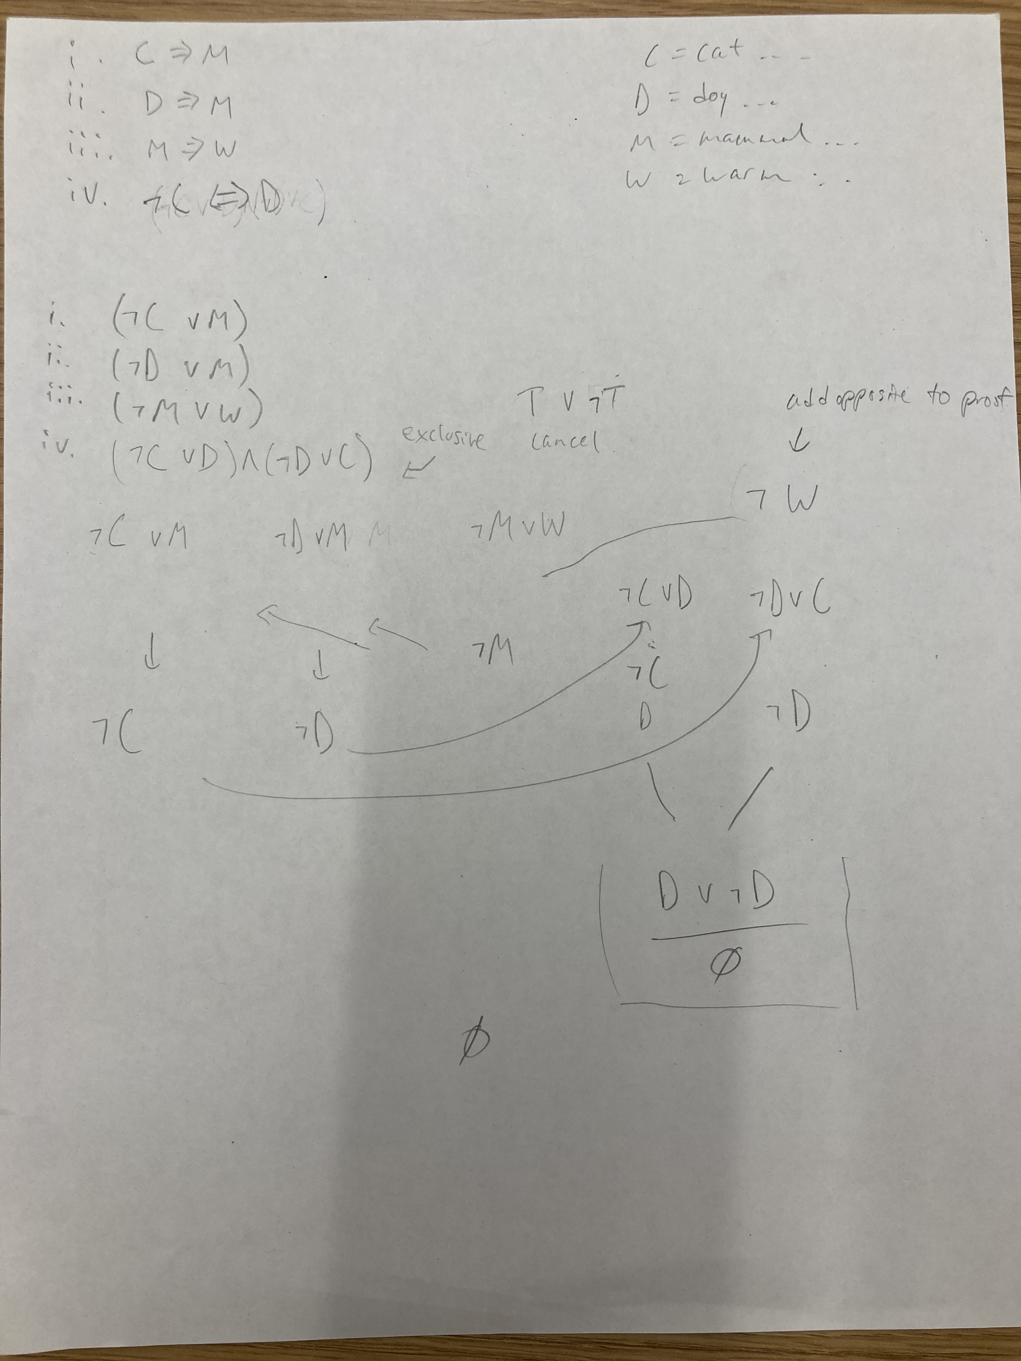
Q5 Logic

